Slide 1

Deep Neural Network Optimization
Advanced strategies for weight initialization, regularization, and gradient stability in deep architectures, Advanced Models (TF), Depth wise separable Convolution
PRESENTED BY
Dr. Ahmed Yousry

Slide 2
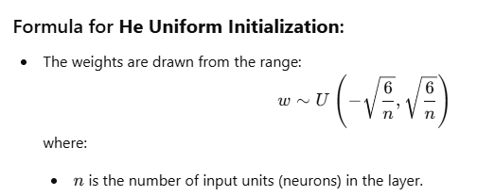
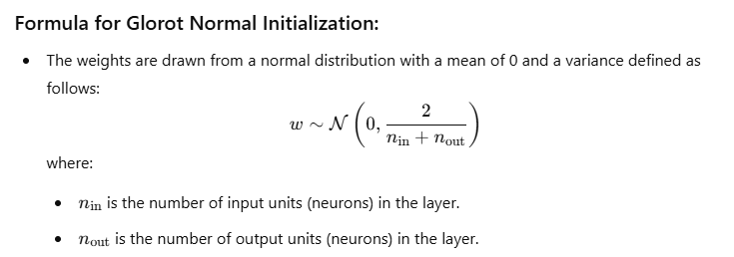
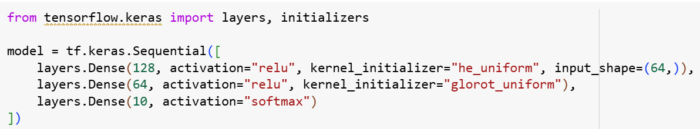
Initialization Weights And Kernel
It helps in achieving faster convergence, avoiding issues like vanishing/exploding gradients, and generally improving the performance of your model.
"he_normal"

Slide 3
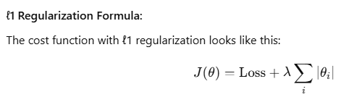

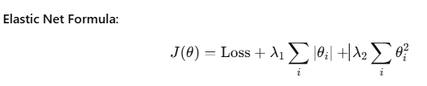
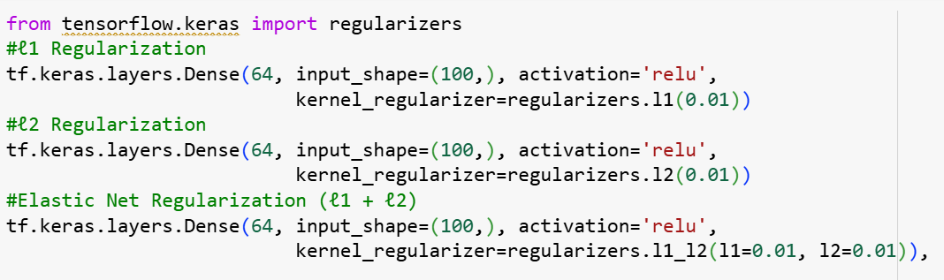
ℓ1 and ℓ2 Regularization
Regularisation is a process of introducing additional information in order to prevent overfitting.

Slide 4
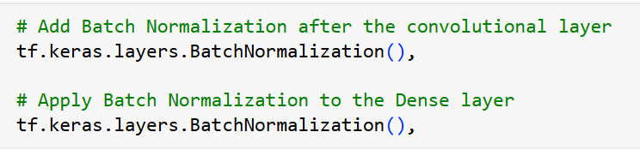
Batch Normalization
- The BatchNormalization layer normalizes the activations by adjusting the mean and variance.
- To avoid overfitting
Notes:
أثناء تدريب الشبكات العصبية، القيم الخارجة من كل طبقة (Activations) قد تتغير توزيعها الإحصائي أثناء التدريب. هذه المشكلة تُسمى:
Internal Covariate Shift
وهذا يجعل التدريب أبطأ لأن الطبقات التالية تضطر دائمًا إلى التكيف مع توزيعات جديدة.
Batch Normalization تحاول حل هذه المشكلة عن طريق توحيد (Normalize) القيم داخل كل Batch أثناء التدريب.
تقنية تجعل مخرجات الطبقات في الشبكة العصبية ذات توزيع ثابت تقريبًا داخل كل Batch، مما يجعل التدريب أسرع وأكثر استقرارًا.
لو توقفنا عند التطبيع فقط قد نقلل قدرة النموذج. لذلك نضيف معاملين قابلين للتعلم:
$γ$(Scale)
$β$(Shift)
$$\text{وهكذا يمكن للشبكة أن تتعلم التوزيع المناسب مرة أخرى إذا احتاجت}\text{.}$$
لماذا Batch Normalization مهمة؟
1️⃣ تسريع التدريب
تجعل التدريب أسرع لأن التوزيع يصبح أكثر استقرارًا.
2️⃣ تسمح باستخدام Learning Rate أكبر
بدون أن ينهار التدريب.
3️⃣ تقلل مشكلة
Vanishing Gradient
Exploding Gradient
4️⃣ تعمل كنوع بسيط من Regularization
لأن كل Batch له إحصائيات مختلفة قليلاً.

Slide 5
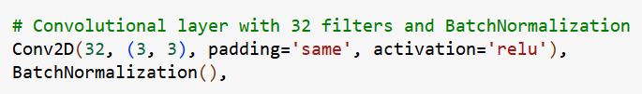
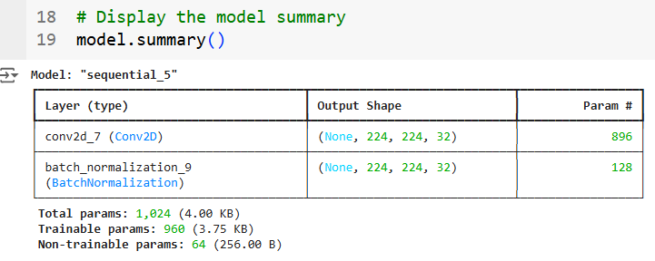
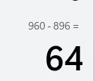
Batch Normalization

Slide 6
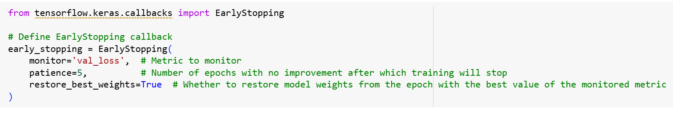
Callbacks
1. EarlyStopping
EarlyStopping is used to stop training once the model performance stops improving on a monitored metric (like validation loss or accuracy). It prevents overfitting and saves time by stopping the training when further epochs would not yield better results.

Slide 7
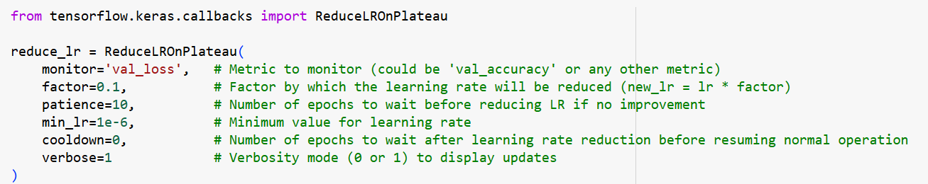
Callbacks
2. ReduceLROnPlateau
ReduceLROnPlateau is used to automatically reduce the learning rate when a monitored metric has stopped improving. Reducing the learning rate can help the model converge more smoothly and prevent it from overshooting minima in the loss landscape.

Slide 8
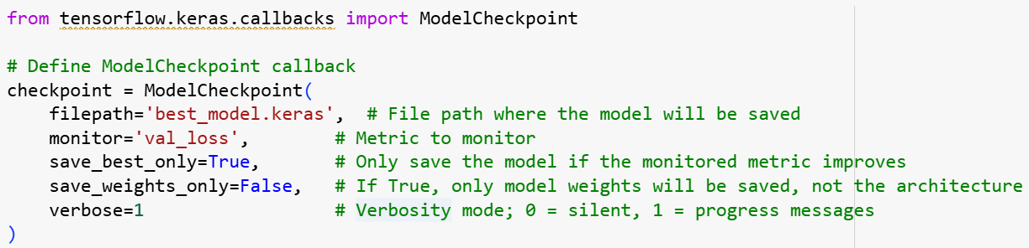
Callbacks
3. ModelCheckpoint
ModelCheckpoint is used to save the model during training at specific points, such as after each epoch or only when the model's performance on a validation set improves. This helps in keeping the best version of the model during training, especially when training for many epochs.

Slide 9
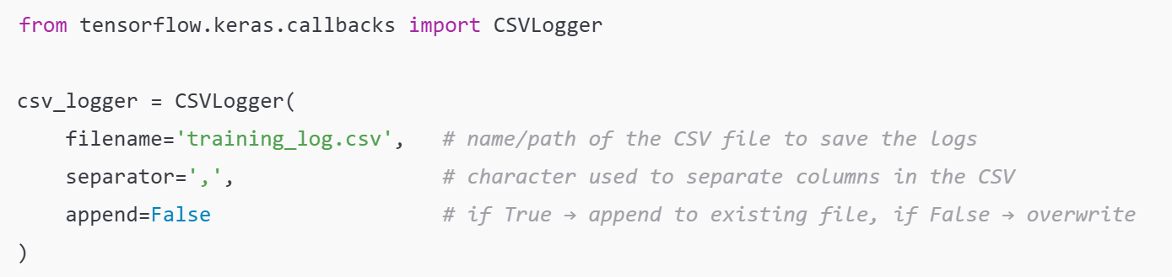
Callbacks
4. CSVLogger
CSVLogger is used to automatically saves the training progress (metrics and loss) of each epoch into a CSV file while the model trains.

Slide 10
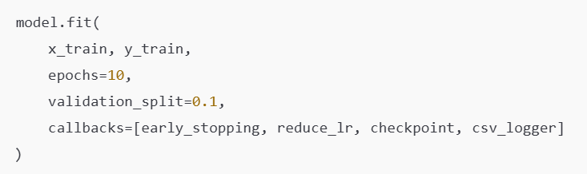
Callbacks
How add in Training Model

Slide 11


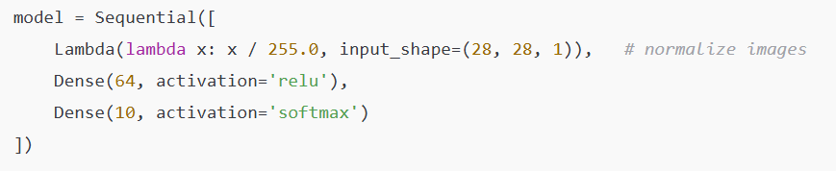
Lambda Function
Lambda layers let you apply custom math or transformations without writing a full custom layer class.

Slide 12
Concatenate Layer
A concatenate layer in neural networks is used to combine multiple input tensors along a specified dimension.
concat = keras.layers.concatenate([ __ ,…, __ ],axis= 0 or 1 )

Slide 13
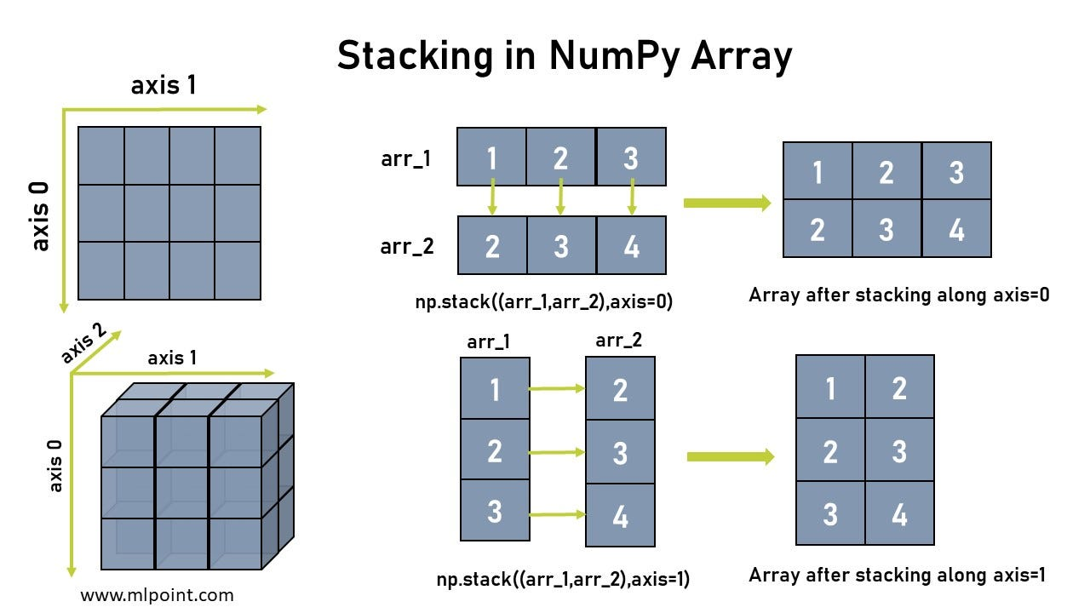
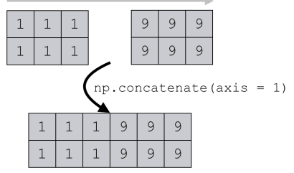
Concatenate Layer
concat = keras.layers.concatenate([input_A, input_B],axis=0)
concat = keras.layers.concatenate([input_A, hidden2],axis=1)

Slide 14
Concatenate Layer
input_A = tf.keras.layers.Input(shape=[5], name="wide_input")
input_B = tf.keras.layers.Input(shape=[6], name="deep_input")
hidden1 = tf.keras.layers.Dense(30, activation="relu")(input_B)
hidden2 = tf.keras.layers.Dense(30, activation="relu")(hidden1)
concat = tf.keras.layers.concatenate([input_A, hidden2], axis=-1)
Aux_output = tf.keras.layers.Dense(1, name="output")(hidden2 )
output = tf.keras.layers.Dense(1, name="output")(concat)
model = tf.keras.Model(inputs=[input_A, input_B], outputs=[output, Aux_output ])

Slide 15
VGG19

Slide 16
ResNet50

Slide 17
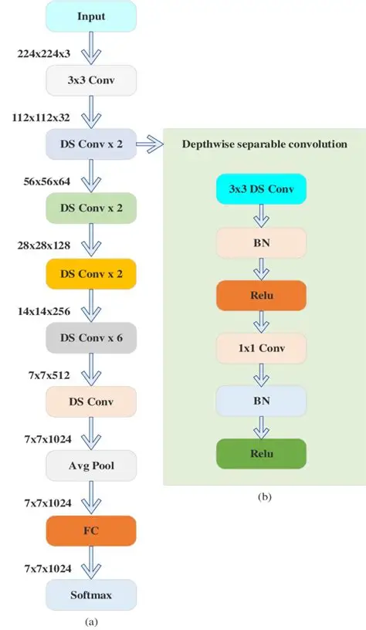
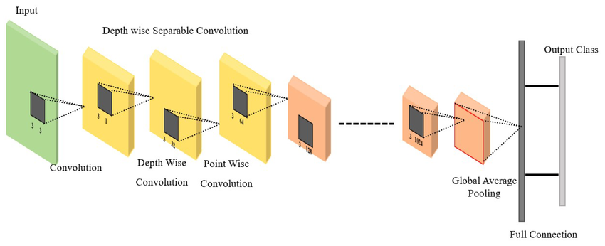
MobileNet

Slide 18
Depthwise Separable Convolution Idea
Instead of applying one convolution across all channels,
we split the operation into two smaller steps:
1) Depthwise Convolution
2) Pointwise Convolution
This dramatically reduces computations.

Slide 19
Depthwise Convolution
How it Works: Unlike standard convolution that looks at all channels at once, Depthwise treats every channel (Red, Green, Blue) as a separate entity.
The Math: Filter Size: K *K *1 (the depth is always 1).
Filter Count: Must equal the number of input channels.
The Benefit: It is extremely computationally efficient, reducing the number of parameters and operations, which is why it is the foundation of mobile-friendly models like MobileNet.

Slide 20
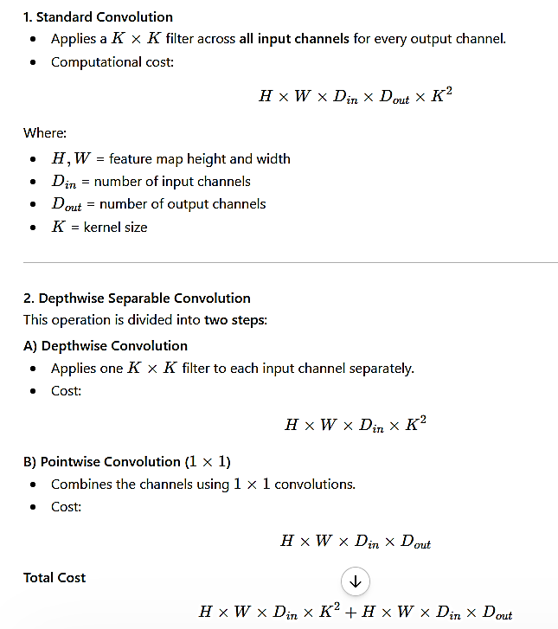
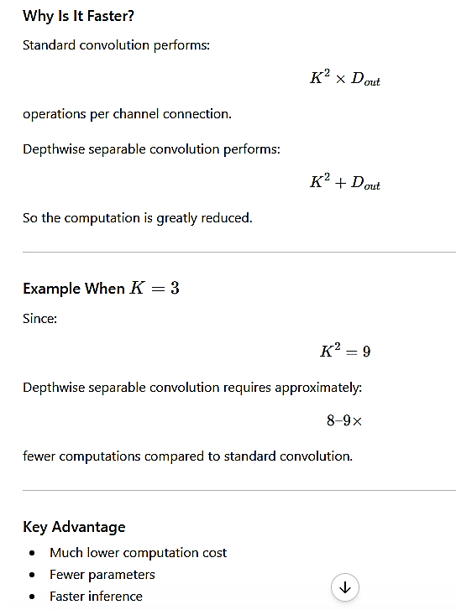


Slide 21
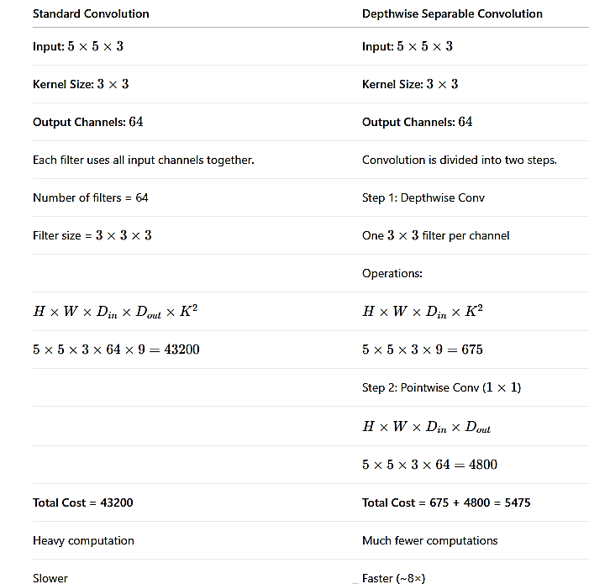

Computations

Slide 22
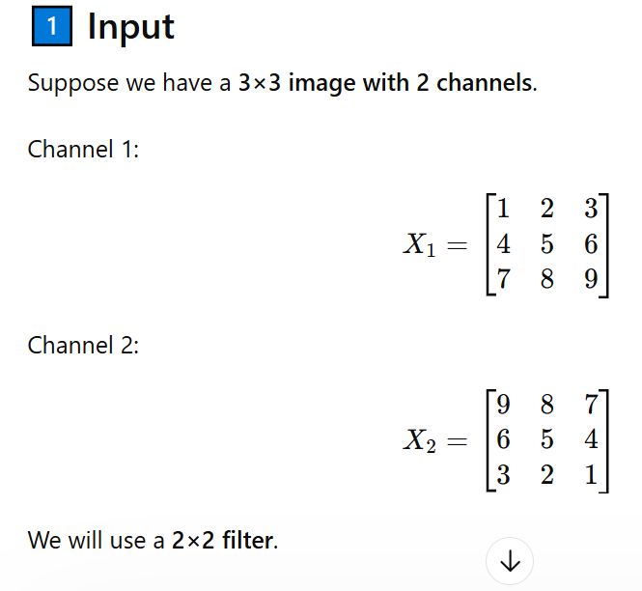

Example

Slide 23
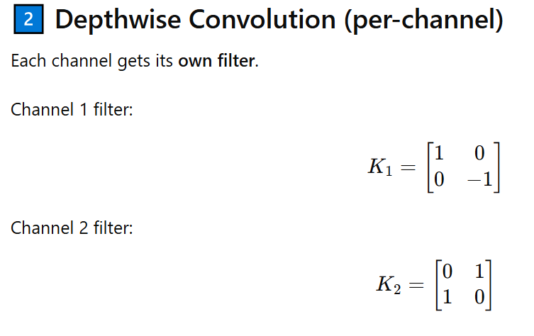
Example

Slide 24
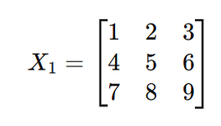
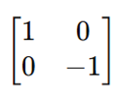
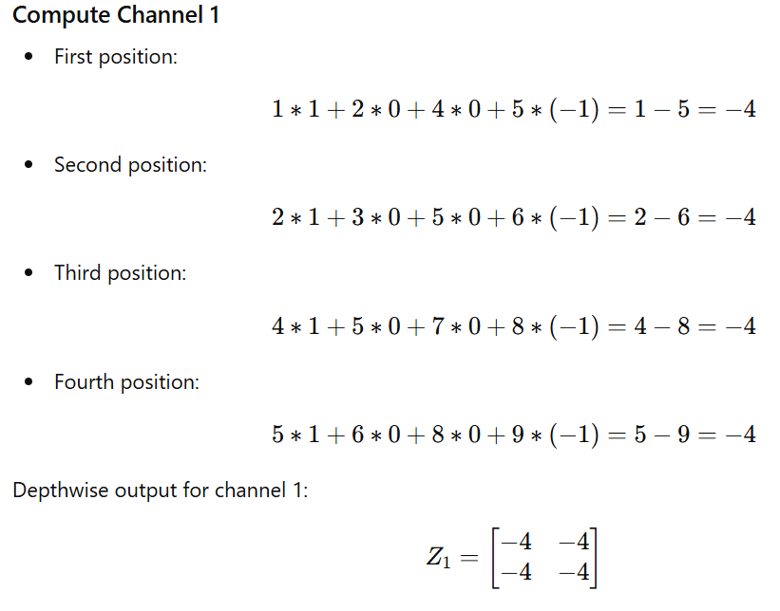
Example

Slide 25
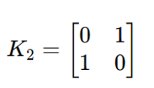
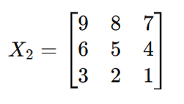
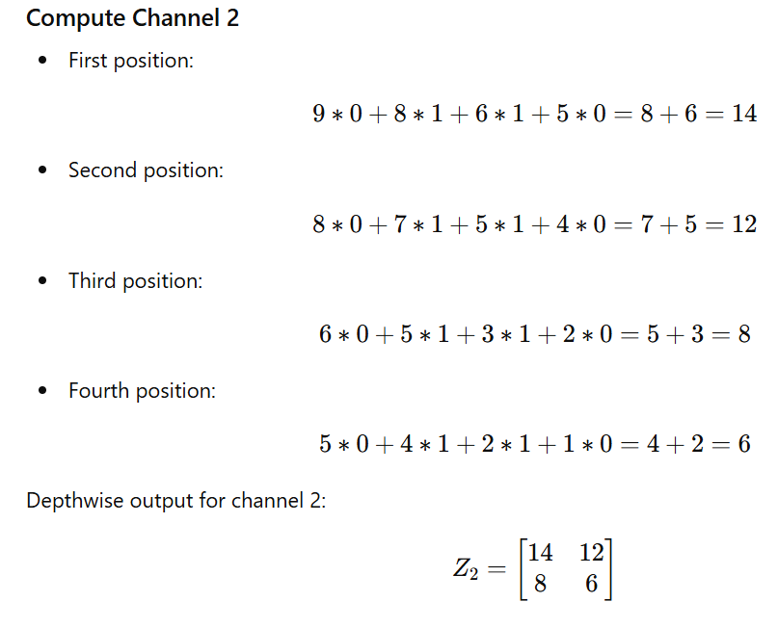
Example

Slide 26
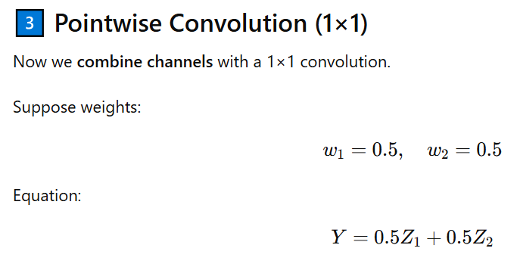
Example

Slide 27


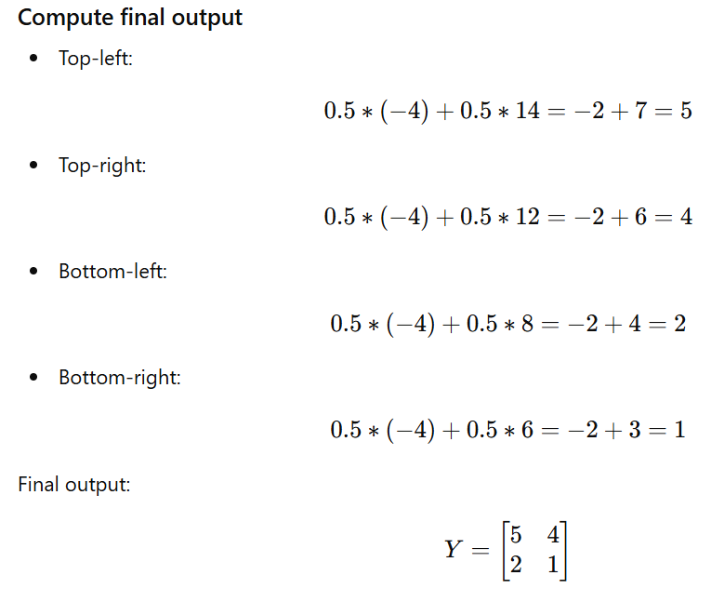
Cont…
tf.keras.layers.SeparableConv2D(filters=64,kernel_size=3,padding='same',input_shape=(224, 224, 32))

Slide 28
InceptionV3

Slide 29
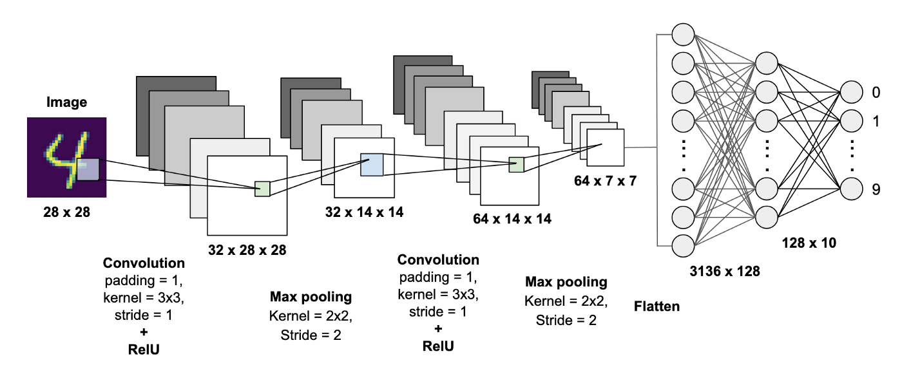
How Call Transfer Learning?
import tensorflow as tf
from tensorflow import keras
model = keras.applications.vgg16.VGG16(weights=' imagenet‘,
include_top=False,
input_shape=(224,224,3))
weights: one of None (random initialization) or 'imagenet' (pre-training on ImageNet).
include_top: whether to include the top layers of the network or not (False,True).

Slide 30
Feature Extraction Mechanism
import tensorflow as tf
from tensorflow import keras
model = keras.applications.vgg16.VGG16(weights='imagenet ' ,include_top=False ,input_shape=(224,224,3))
model.trainable = False
for layer in model.layers[:-1]:
layer.trainable = False
model.layers[0].trainable = False
model.get_layer('conv2d_1').trainable = False

